Slide 1
Theseus and Minotaur
Isaac Mackle

Slide 2
My Controller, View and Model
Auto generating maze based on level data

Slide 3
Expected Mark for View
Expected mark
This view automatically generates the maze based on level data. There are 3 different levels that it can generate and the view implements all of the MUST features of the view.
4/4 (10%)

Slide 4
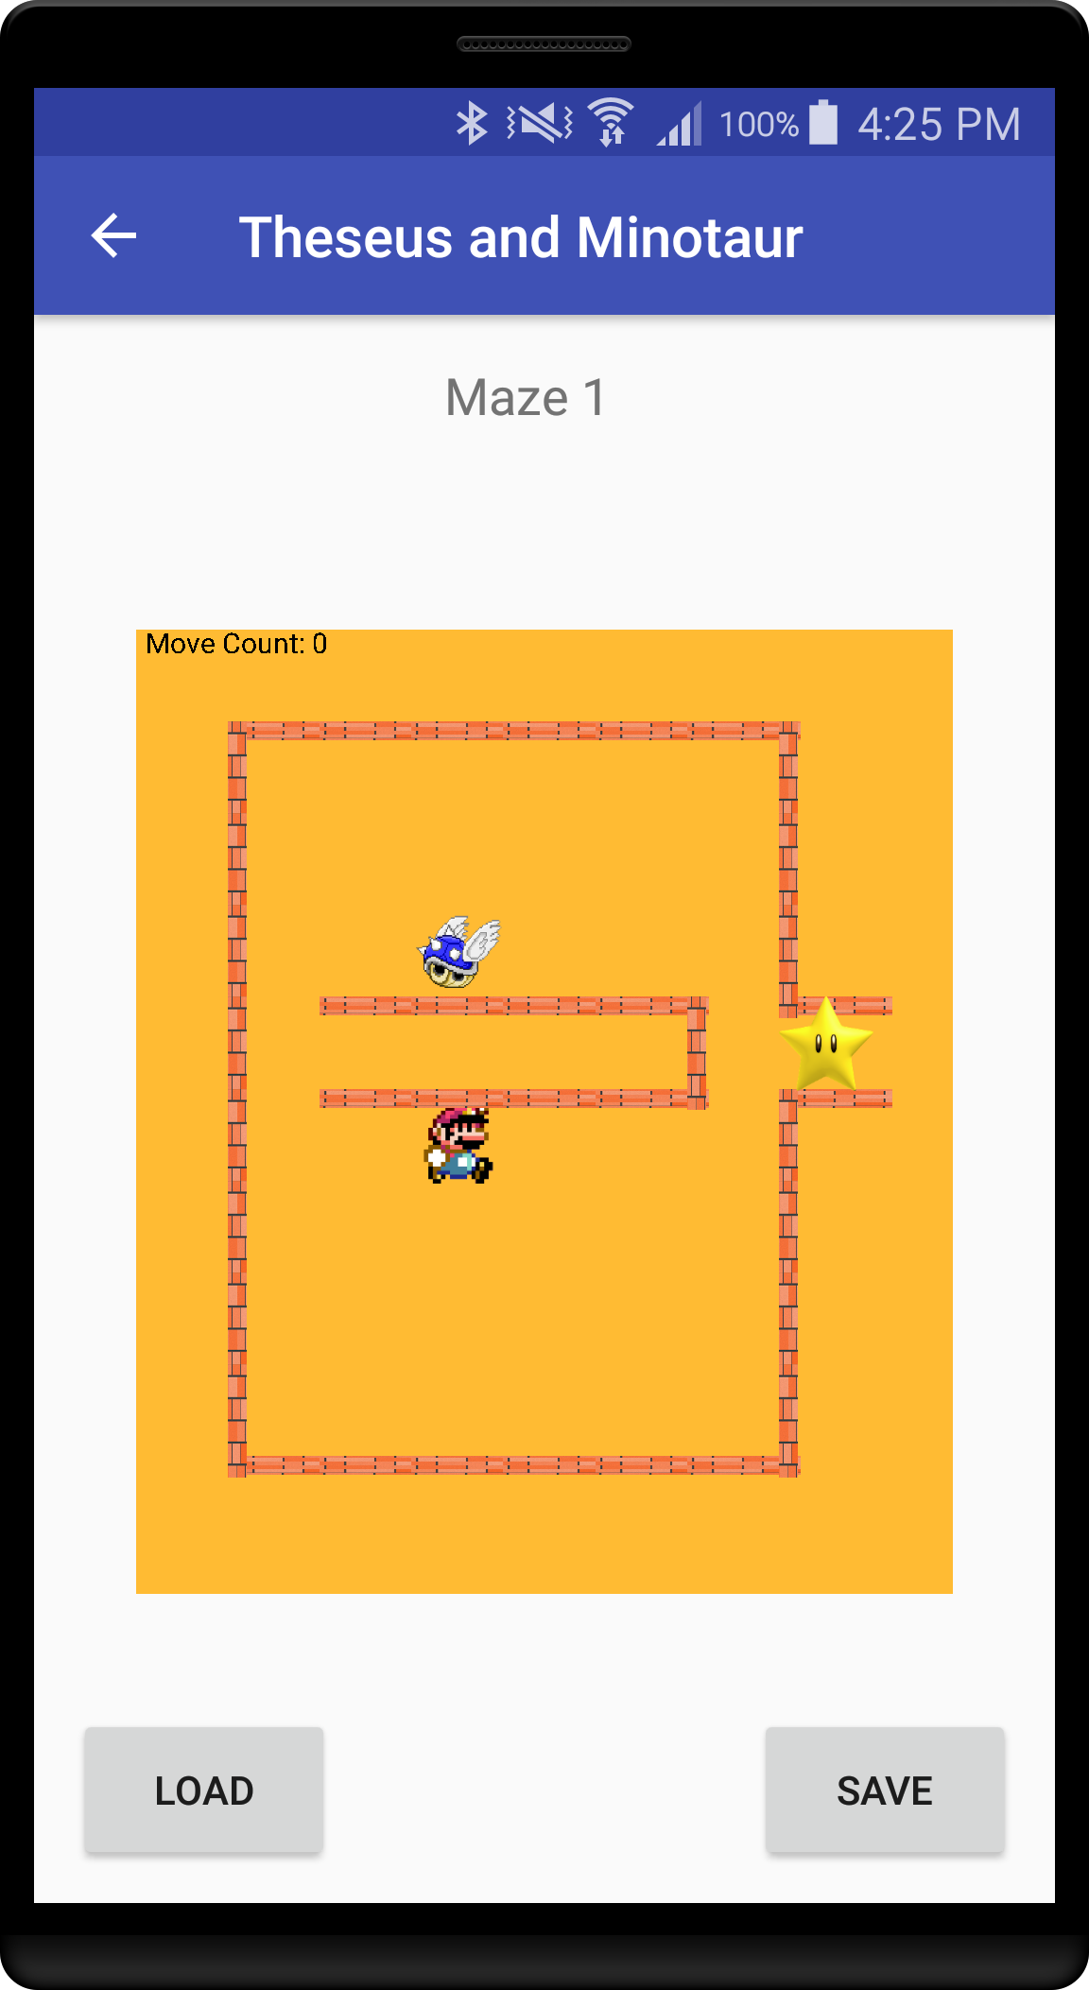
MUST feature #1
Button for Loading Level

Slide 5
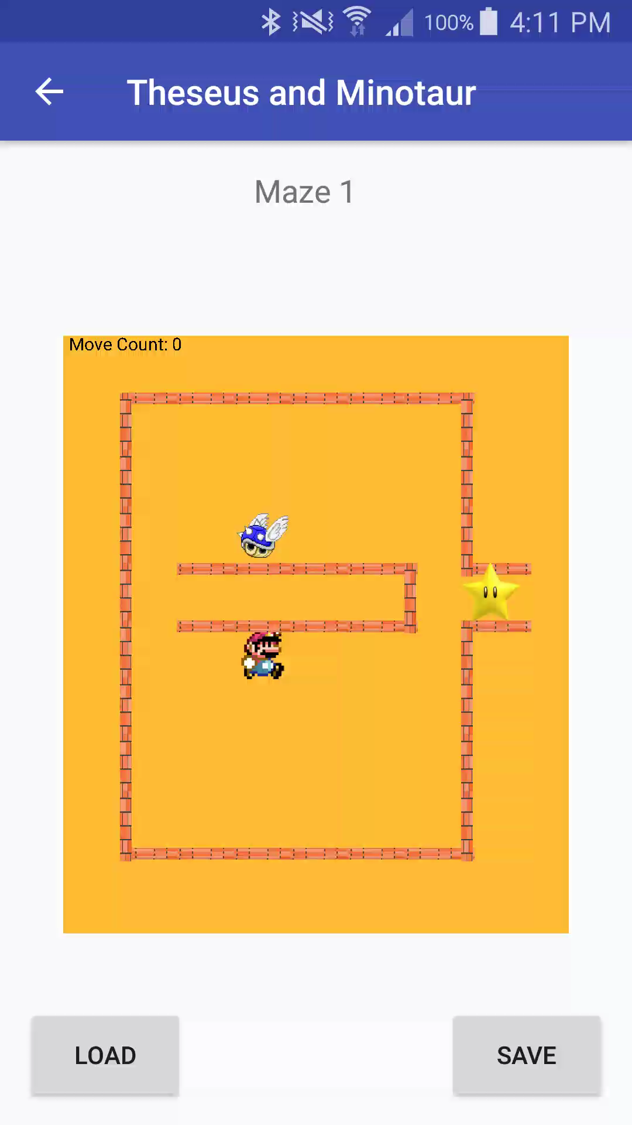
Must Feature #1 - Video
Video Of Feature

Slide 6
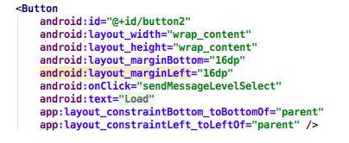
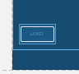
Must Feature #1- code example
Code Example of XML and Layout
This is the xml of the button
Blueprint layout

Slide 7
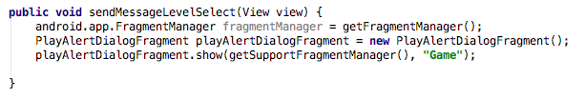
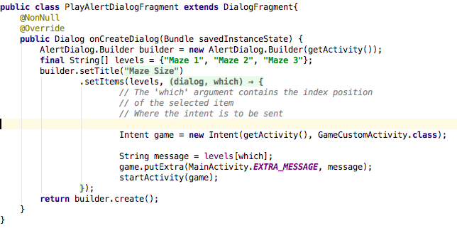
Must Feature #1- code example
When the load button is pressed, the PlayAlertDialogFragment is called
This fragment brings up options of Maze1, Maze 2 or Maze 3. This then Starts the GameCustomActivity, with the message of which level(Maze1, Maze2, Maze3), which activates the custom view and the selected level is shown.

Slide 8
Must Feature #1- expected mark
Expected mark
The Load Button opens up a fragment that gives the user 3 different level options. This then loads the default level data for the view to display.
1/1

Slide 9
MUST feature #2
Button for Saving Level

Slide 10

Must Feature #2 - Video
Video Of Feature

Slide 11
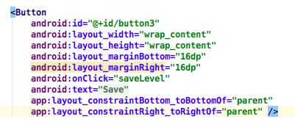
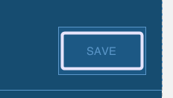
Must Feature #2- code example
Code Example of XML and Layout
This is the xml of the button
Blueprint layout

Slide 12
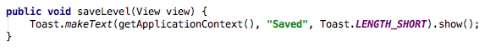
Must Feature #2- code example
When the savebutton is pressed, the saveLevel() function is called. This displays a toast with the value of “saved”.

Slide 13
Must Feature #2- expected mark
Expected mark
The Save Button creates a toast message that displays “saved” but no actual data is saved. This is because I don’t read my level data from a file but this still passes my must feature as the feature is to display a button for saving.
0.8/1

Slide 14
MUST feature #3
Theseus Movement:
Left
Right
Up
Down
Pause

Slide 15
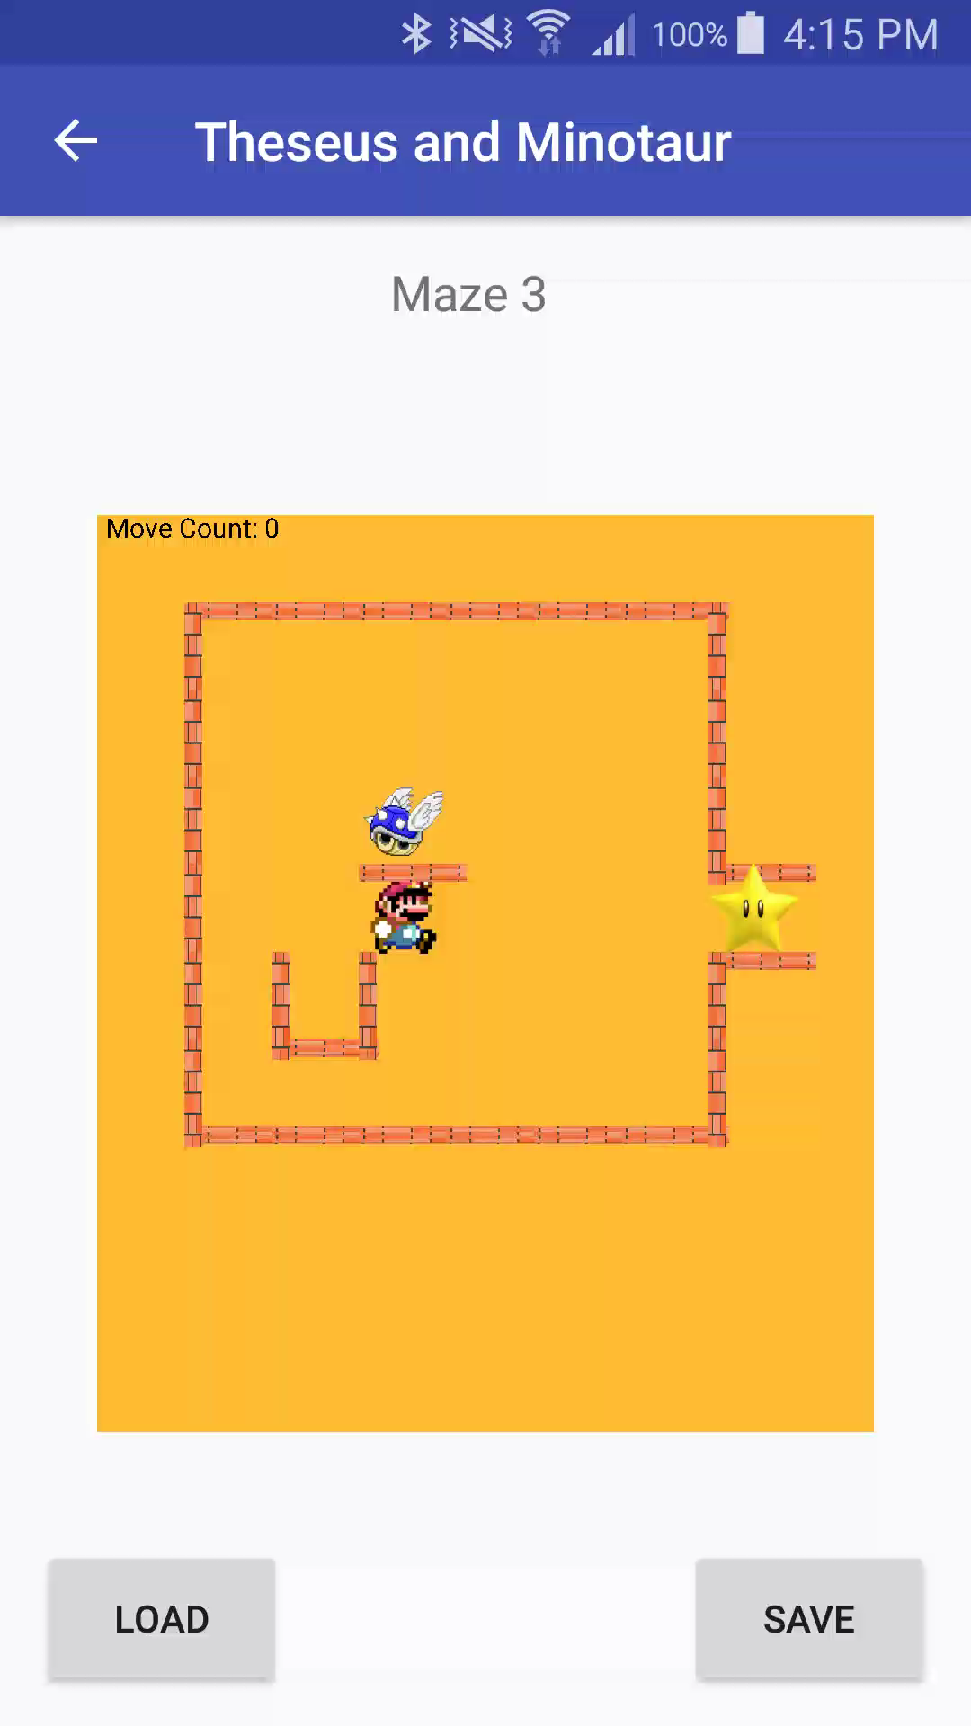
Must Feature #3 - Video
Video Of Feature
Theseus’ Movement

Slide 16
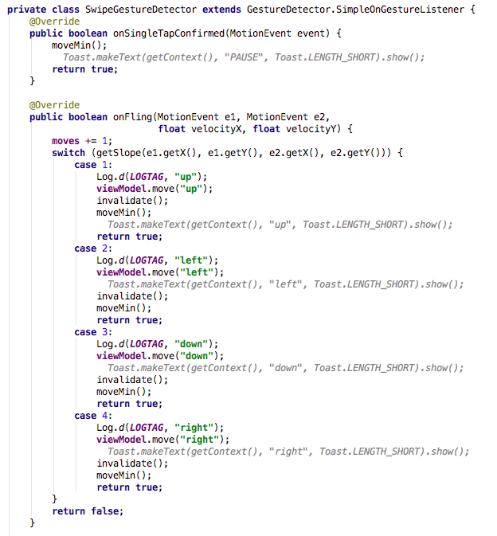
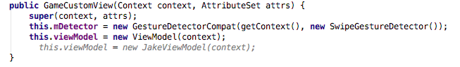
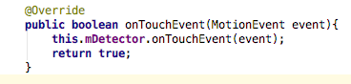
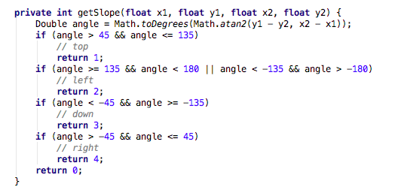
Must Feature #3- code example
1. Setup of Gesture Detector
2. Called when the screen is touched
3. The SwipeGestureDetector checks for a single tap action (which pauses theseus) and a fling action (which moves theseus, left, right, up or down).
To implement the movement, the view calls the viewModel which talks to the model.
To pause Theseus a single tap activates this and calls the movement of minotaur without any movement of Theseus
4. This works out the direction of the swipe (up, down, left, right) and is called by onFling()

Slide 17
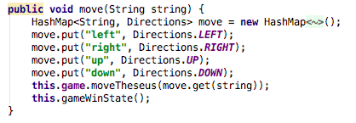
Must Feature #3- code example
5. This is the code in viewModel that calls the movement code in the gameModel.

Slide 18
Must Feature #3- expected mark
Expected mark
The movement of Theseus works very well. Can move up, down, left, right and pause Theseus.
5/5

Slide 19
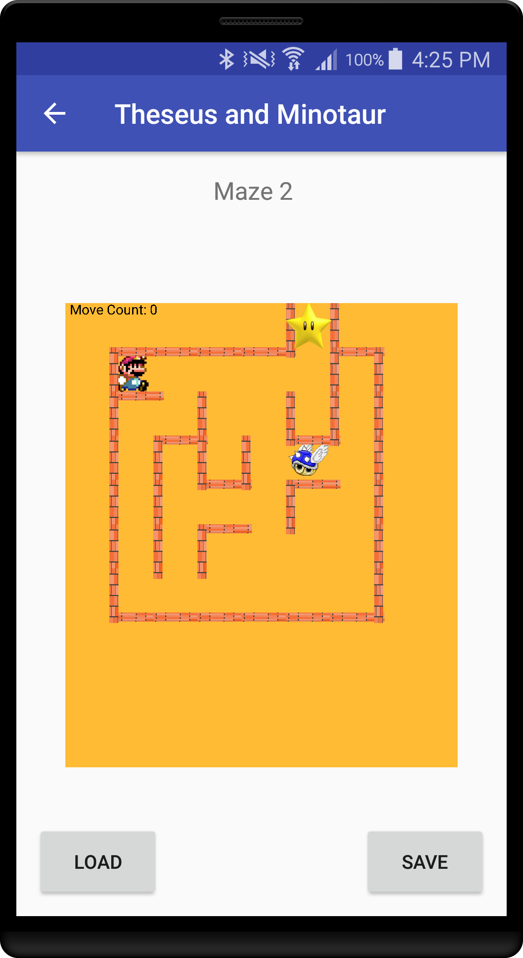
MUST feature #4
Displaying Image of Theseus

Slide 20
Must Feature #4 - Video
Video Of Feature
Image of Theseus

Slide 21
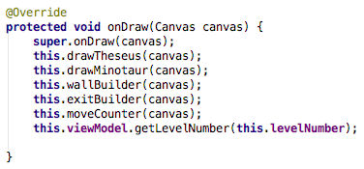
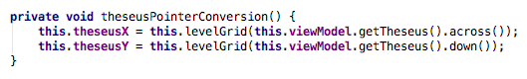
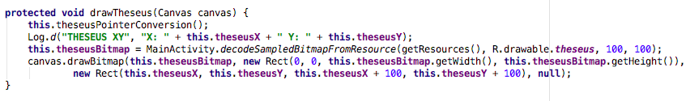
Must Feature #4- code example
1. onDraw calls the drawTheseus() Function
3. To convert the Pointer size, levelGrid() is called with either the across pointer location or the depth pointer location
2. When drawTheseus() is called, theseusPointerConversion() is called to increase the pointer size
to match the screen size, otherwise Theseus would be really small on the screen.
Once the Pointer size is determined, a bitmap of Theseus is created then drawn on the screen

Slide 22
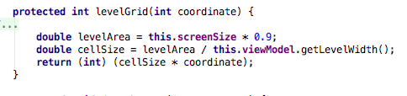
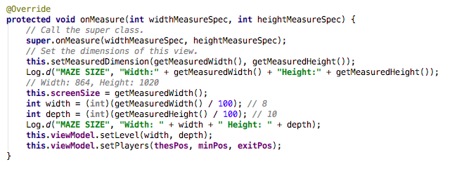
Must Feature #4- code example
4. levelGrid() gets the screensize (getMeasuredWidth()) and adds a little bit of padding. The cell size is the levelArea divided by the width of the game model level. The cellSize * the coordinate is the new pointer size
5. This is the function that determines the size of the level

Slide 23
Must Feature #4- expected mark
Expected mark
Theseus is displayed on the screen and is redrawn when there is a valid swipe on the screen.
1/1

Slide 24
MUST feature #5
Displaying Image of Minotaur

Slide 25
Must Feature #5 - Video
Video Of Feature
Image of Minotaur

Slide 26
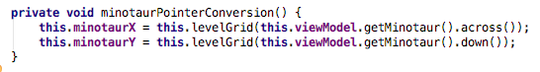
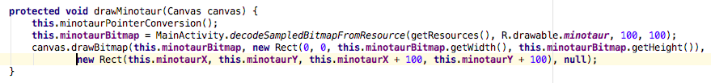
Must Feature #5- code example
1. onDraw calls the drawMinotuar() Function
3. To convert the Pointer size, levelGrid() is called with either the across pointer location or the depth pointer location
2. When drawMinotaur() is called, theseusPointerConversion() is called to increase the pointer size
to match the screen size, otherwise Minotaur would be really small on the screen.
Once the Pointer size is determined, a bitmap of Minotaur is created then drawn on the screen

Slide 27
Must Feature #5- code example
4. levelGrid() gets the screensize (getMeasuredWidth()) and adds a little bit of padding. The cell size is the levelArea divided by the width of the game model level. The cellSize * the coordinate is the new pointer size
5. This is the function that determines the size of the level

Slide 28
Must Feature #5- expected mark
Expected mark
Minotaur is displayed on the screen and is redrawn when Theseus moves or pauses.
1/1

Slide 29
MUST feature #6
Displaying Image of Goal/Exit

Slide 30
Must Feature #6 - Video
Video Of Feature
Image of Goal

Slide 31
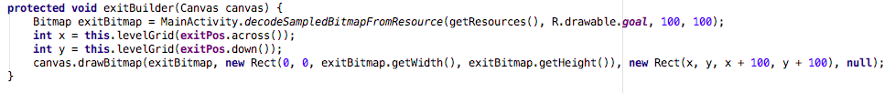
Must Feature #6- code example
1. onDraw calls the exitBuilder() Function
2. When exitBuilder() is called, a bitmap of the exit is created. Then the Pointer conversion is done with the levelGrid() function.
Once the Pointer size is determined, the exit bitmap is drawn on the screen

Slide 32
Must Feature #6- code example
3. levelGrid() gets the screensize (getMeasuredWidth()) and adds a little bit of padding. The cell size is the levelArea divided by the width of the game model level. The cellSize * the coordinate is the new pointer size
4. This is the function that determines the size of the level

Slide 33
Must Feature #6- expected mark
Expected mark
Exit/Goal is displayed on the screen in the correct place
1/1

Slide 34
MUST feature #7
Auto generating a maze based on level data

Slide 35
Must Feature #7 - Video
Video Of Feature
Maze is working

Slide 36
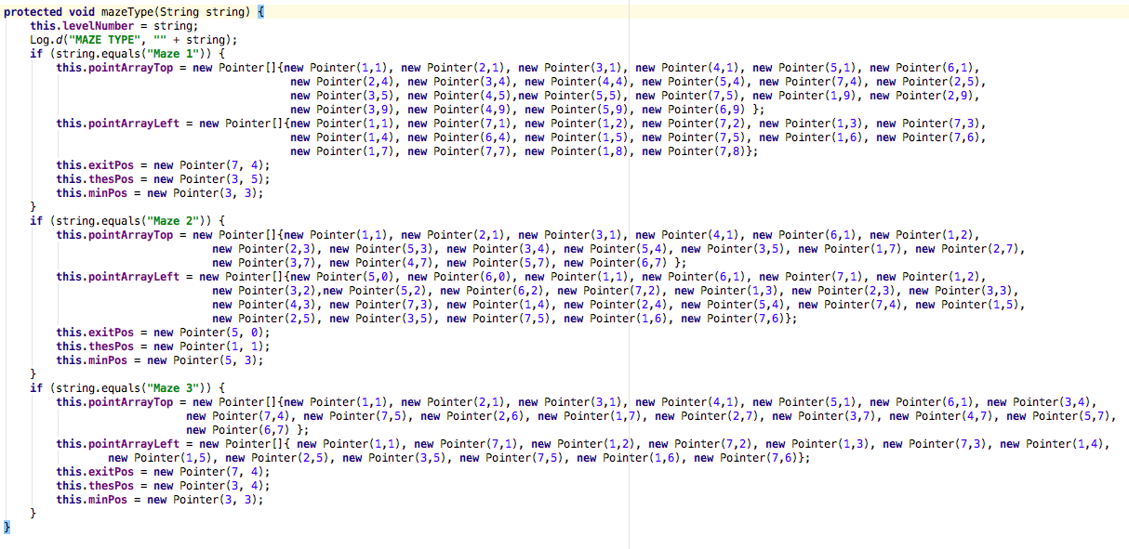
Must Feature #7- code example
mazeType() is the function that stores that data of the walls, Theseus, Minotaur and the Exit. The level number is decided by what is passed in from the GameCustomActivity.

Slide 37
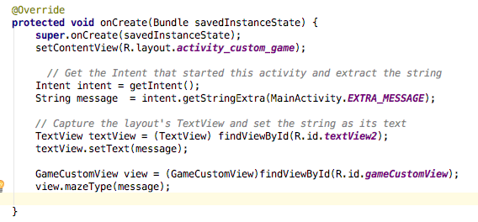
Must Feature #7- code example
2. The GameCustomActivity receives an intent from the level select fragment with the maze number as a string extra. This string is passed into the mazeType() function of the custom view to decide which maze will be created by setting the different variables for the position of the walls, Theseus, Minotaur and exit.
3. This is how all the required Points for the model are decided.

Slide 38
Must Feature #7- expected mark
Expected mark
The maze is automatically generated based off whichever level number is passed in. However this way of doing things isn’t very reusable and if more mazes were to be added it wouldn’t be as easy as it could. Due to time constraints and my level of knowledge this was the way I decided how to do it.
0.75/1

Slide 39
MUST feature #8
Display a maze / Draw the walls

Slide 40
Must Feature #8 - Video
Video Of Feature
Maze is working

Slide 41
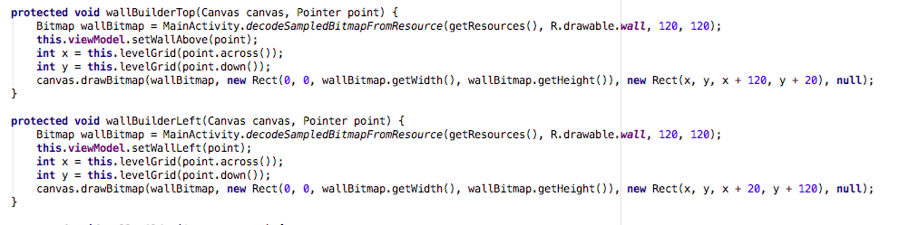
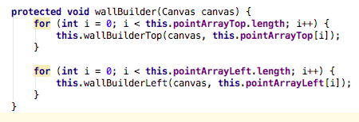
Must Feature #8- code example
The maze is displayed automatically from the data as seen in the last feature
2. To draw the walls, I have a wallBuilderTop() and wallBuilderLeft() function which both create a wall bitmap, take in a point and set the wall location, then convert the size of the point to fit the screen correctly and then they draw the bitmap. The difference being whether it’s a top wall or left wall. These functions are called by the wallBuilder() function.
3. The wallBuiler() function loops through the array of points for either the top/left wall which were set by the mazeType() at the start of the activity. This then
runs a forloop that passes in a point to either the top/left wall builder to then be drawn on the screen.

Slide 42
Must Feature #8- code example
4. onDraw calls the wallBuilder() Function

Slide 43
Must Feature #8- expected mark
Expected mark
The maze and walls are both displayed based on the level data.
2/2

Slide 44
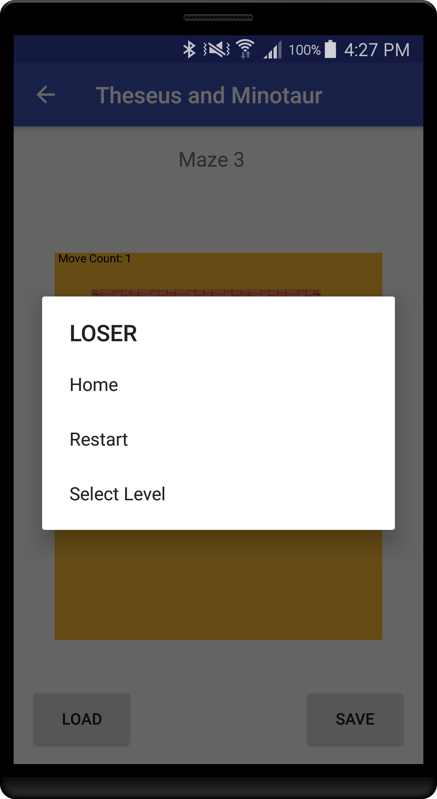
MUST feature #9
Dialog if Minotaur kills Theseus

Slide 45

Must Feature #9 - Video
Video Of Feature
Dialog of loser

Slide 46
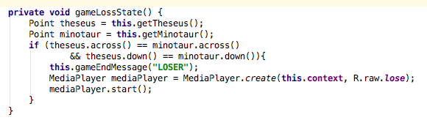
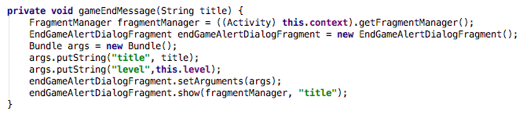
Must Feature #9- code example
1. This function is in the viewModel (Controller) and is called after a Minotaur move. It checks to see if the Point of Theseus matches the Point of
the Minotaur. If it does it calls gameEndMessage().
2. The gameEndMessage() function creates a fragment dialog that pops up if the Minotaur Kills Theseus.

Slide 47
Must Feature #9- expected mark
Expected mark
A dialog is displayed with the text “Loser” when Minotaur kills Theseus.
1/1

Slide 48
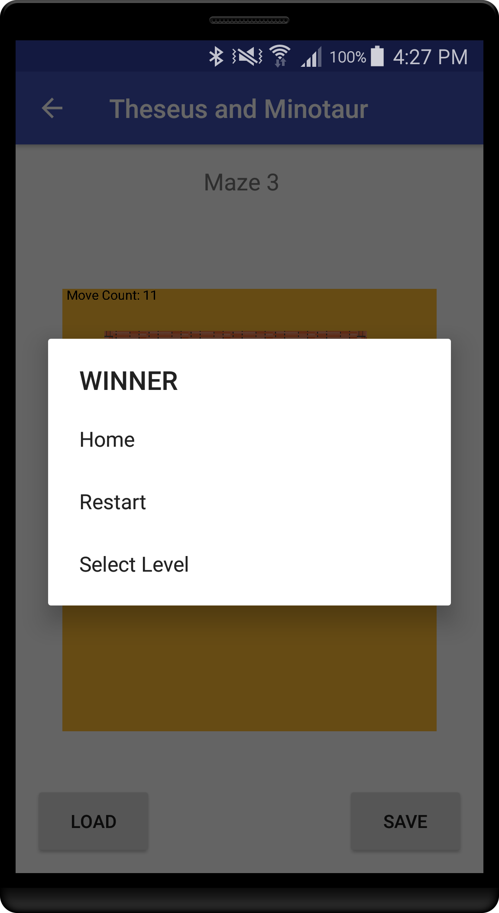
MUST feature #10
Dialog if Theseus wins/escapes

Slide 49

Must Feature #10 - Video
Video Of Feature
Dialog of Winner

Slide 50
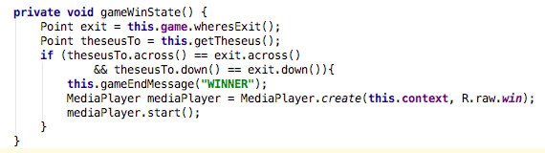
Must Feature #10- code example
1. This function is in the viewModel (Controller) and is called after a Theseus move. It checks to see if the Point of Theseus matches the Point of
the exit. If it does it calls gameEndMessage().
2. The gameEndMessage() function creates a fragment dialog that pops up if Theseus Wins.

Slide 51
Must Feature #10- expected mark
Expected mark
A dialog is displayed with the text “WINNER” when Theseus wins.
1/1

Slide 52
MUST feature #11
Dialog with options after Theseus has been killed

Slide 53
Must Feature #11 - Video
Video Of Feature
Dialog of loser with options

Slide 54
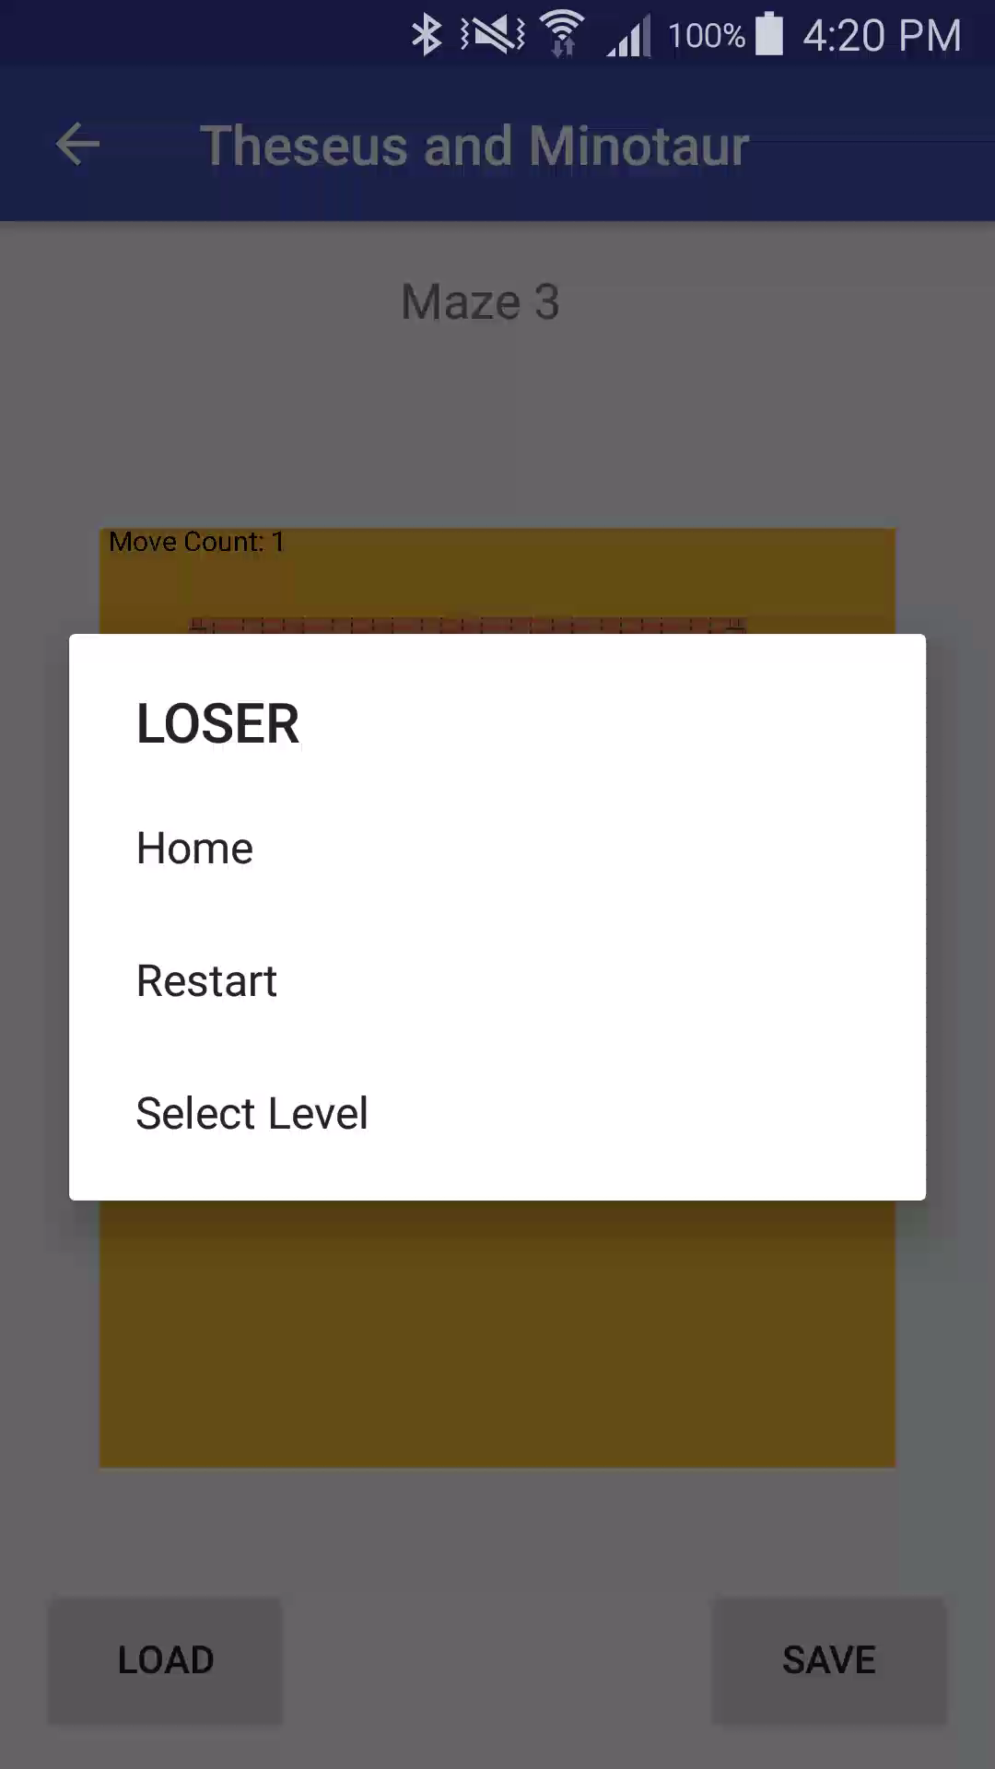

Must Feature #11 - Video
Video Of Feature
Pressing Home Button
Pressing Restart Button
Pressing Select Level Button

Slide 55
Must Feature #11- code example
1. This function is in the viewModel (Controller) and is called after a Minotaur move. It checks to see if the Point of Theseus matches the Point of
the Minotaur. If it does it calls gameEndMessage().
2. The gameEndMessage() function creates a fragment dialog that pops up if the Minotaur Kills Theseus.

Slide 56
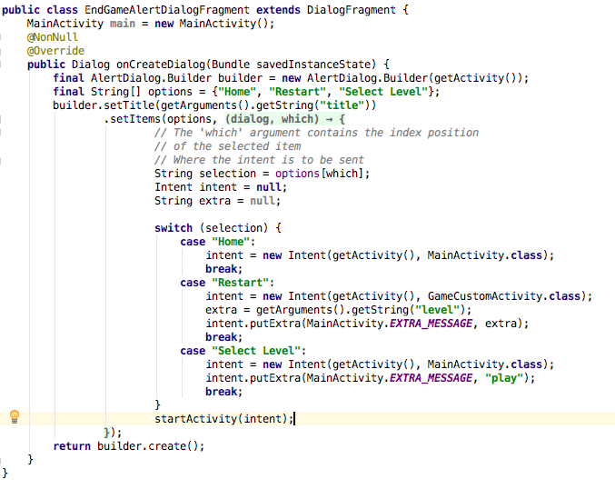
Must Feature #11- code example
3. The EndGameAlertDialogFragment is the popup with options that appears when Theseus loses. The option data is passed to the GameCustomActivity to
handle the different options.

Slide 57
Must Feature #11- expected mark
Expected mark
A dialog is displayed with the text “Loser” when Minotaur kills Theseus. And displays 3 different options that can be pressed to achieve different things.
1/1

Slide 58
MUST feature #12
Dialog with options after Theseus exits successfully

Slide 59
Must Feature #12 - Video
Video Of Feature
Dialog of winner with options

Slide 60
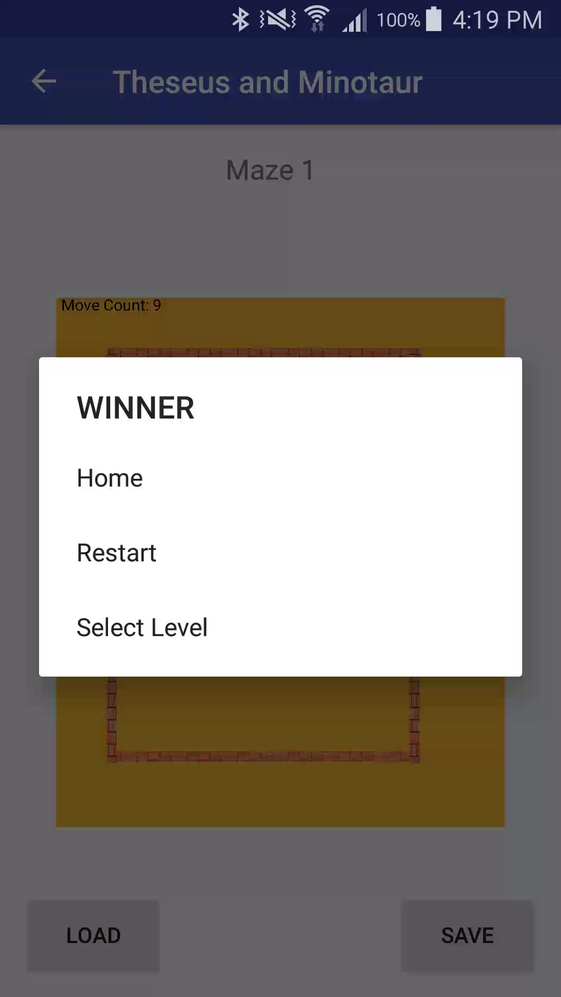

Must Feature #12 - Video
Video Of Feature
Pressing Home Button
Pressing Restart Button
Pressing Select Level Button

Slide 61
Must Feature #12- code example
1. This function is in the viewModel (Controller) and is called after a Theseus move. It checks to see if the Point of Theseus matches the Point of
the exit. If it does it calls gameEndMessage().
2. The gameEndMessage() function creates a fragment dialog that pops up if Theseus Wins.

Slide 62
Must Feature #12- code example
3. The EndGameAlertDialogFragment is the popup with options that appears when Theseus wins. The option data is passed to the GameCustomActivity to
handle the different options.

Slide 63
Must Feature #12- expected mark
Expected mark
A dialog is displayed with the text “WINNER” when Theseus wins/ exits. And displays 3 different options that can be pressed to achieve different things.
1/1

Slide 64
MUST feature #13
Display move counts

Slide 65

Must Feature #13 - Video
Video Of Feature
Move count

Slide 66
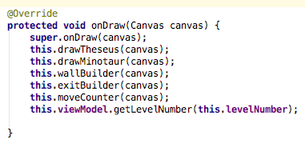
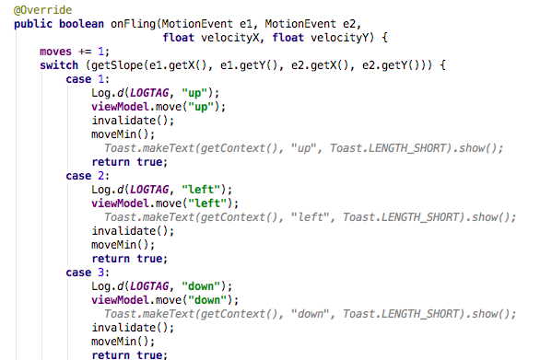
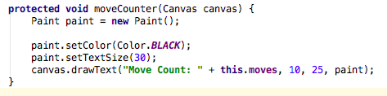
Must Feature #13- code example
1. The onDraw() function calls the moveCounter() to update on each draw
3. The moves variable is updated on every valid Theseus move
2. The moveCounter() function creates a new paint object that draws the
test onto the canvas

Slide 67
Must Feature #13- expected mark
Expected mark
The moves of Theseus are counted and displayed
1/1

Slide 68
MUST feature #14
Play a sad noise after Theseus has been killed

Slide 69

Must Feature #14 - SOund
Sound Of Feature
Sound of Losing
Wasn’t sure how to record the losing sound while playing the game but this is what it sounds like

Slide 70
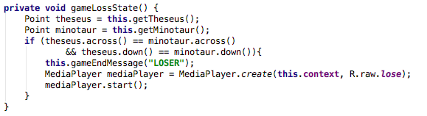
Must Feature #14- code example
1. This function is in the viewModel (Controller) and is called after a Minotaur move. It checks to see if the Point of Theseus matches the Point of
the Minotuar. If it does then the endGame dialog is displayed and the sound is played.

Slide 71
Must Feature #14- expected mark
Expected mark
A sad noise is played after Theseus has been killed
1/1

Slide 72
MUST feature #15
Play a happy noise after Theseus exits Successfully

Slide 73
Must Feature #15 - SOund
Sound Of Feature
Sound of Winning
Wasn’t sure how to record the winning sound while playing the game but this is what it sounds like

Slide 74
Must Feature #15- code example
1. This function is in the viewModel (Controller) and is called after a Theseus move. It checks to see if the Point of Theseus matches the Point of
the exit. If it does then the endGame dialog is displayed and the sound is played.

Slide 75
Must Feature #15- expected mark
Expected mark
A happy noise is played after Theseus has been exited successfully
1/1

Slide 76
Could Have feature #1
Minotaur has 2 distinctive moves

Slide 77
Could Have Feature #1 - Video
Video Of Feature
Minotaur moves distinctively

Slide 78
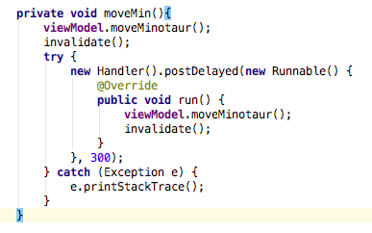
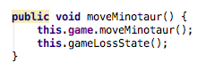
Could Have Feature #1- code example
1. To get the Minotaur to have two distinctive moves, a timer had to be implemented so that
the canvas could draw Minotaur, before it moves again. This is done with the code shown below. moveMin() is called after a Theseus move.
2. This is the viewModel (Controller) code

Slide 79
Could Have Feature #1- expected mark
Expected mark
The Minotaur has two distinct moves
1/1

Slide 80
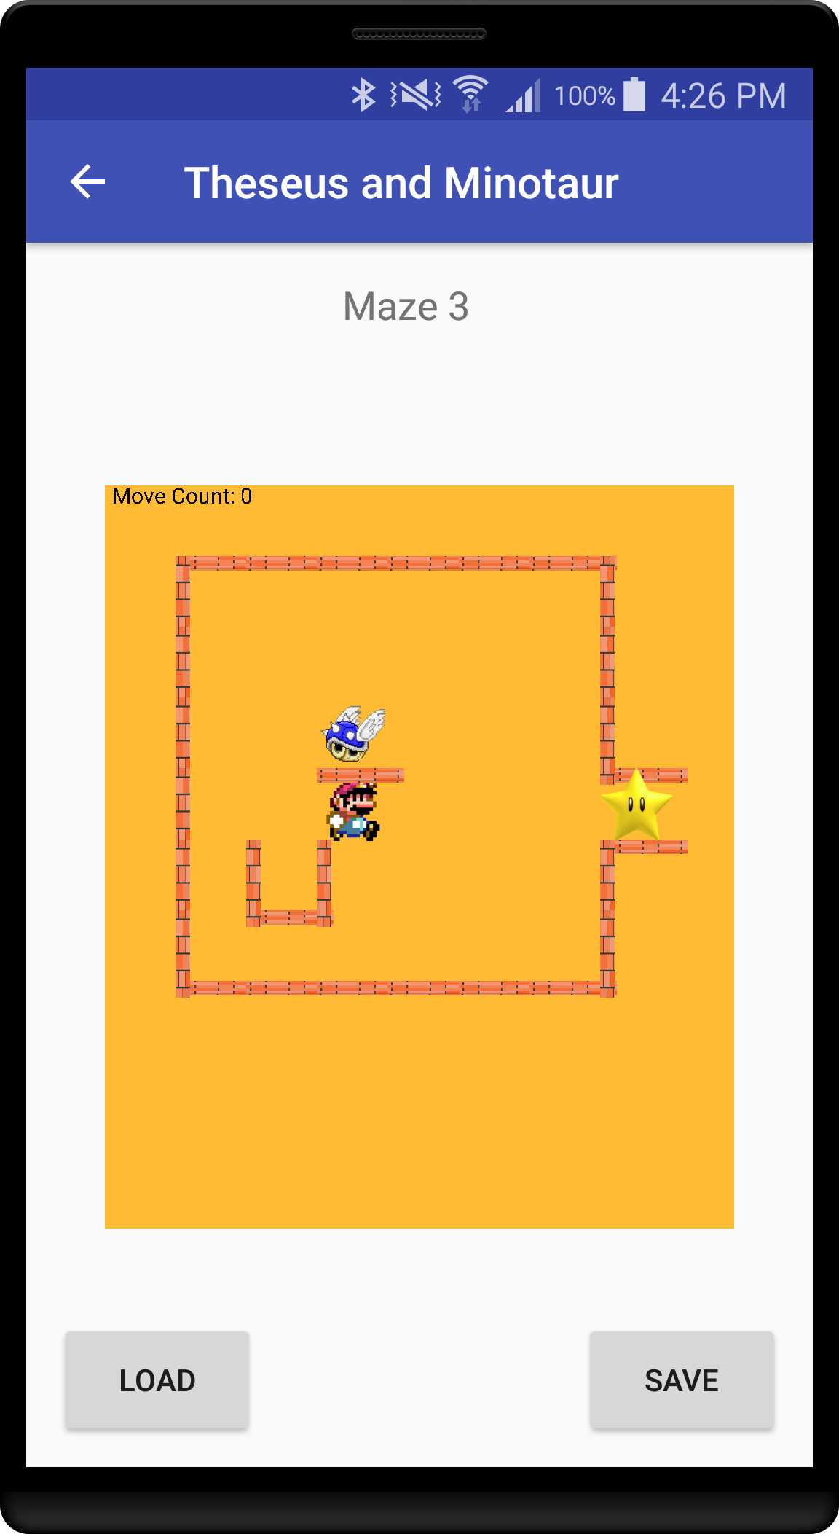
Could Have feature #2
Display Level Name

Slide 81
Could Have Feature #1 - Video
Video Of Feature
Different level names

Slide 82
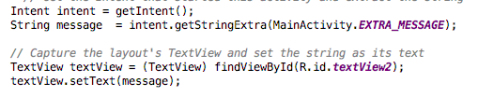
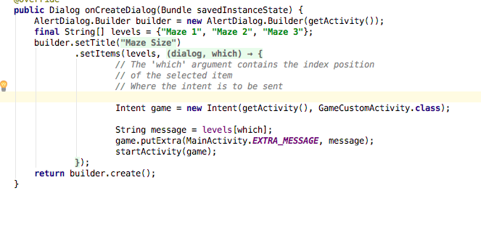
Could Have Feature #2- code example
In the onCreate of the GameCustomActivity I grab the intent, which contains the name of the maze as an extra string. This then sets the textView on the view to that string
2. This is the fragment that sends the maze name to the intent for the GameCustomActivity to achieve

Slide 83
Could Have Feature #2- expected mark
Expected mark
The level name is displayed
1/1

Slide 84
My Controller and View With Jacob's Model

Slide 85
Jacob’s Model
Jacob’s model followed the interfaces that I did but had a couple of different names for some of the classes.
My Pointer = his PointImpl
My Part = his Actor
He also used a cell class that helped to create the level but it had different functionality so I had to also import his cell class so that his model would work.

Slide 86
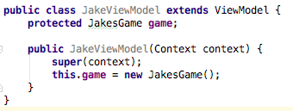
Jacob’s Model
To get Jacob’s model working with my view all I had to do was subclass my viewModel(controller) so that it referenced JakesGame instead of my GameModel.
It was this easy as he had the same interfaces so therefore all the public methods where called the same

Slide 87
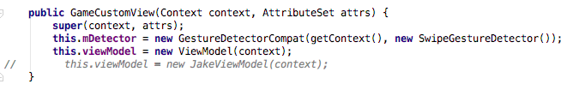
Jacob’s Model
In my view I just need to change which view model I instantiate

Slide 88
Jacob’s Model

Slide 89
Jacobs Model
Expected mark
I got Jacobs model working with my controller and view with little trouble. All the functionality works correctly
10/10 (10%)

Slide 90
Theory #1
Produce and execute testing strategies at the systems level using a unit testing framework

Slide 91
State the Theory
Writing unit tests before you write the code is recommended as it makes you think through exactly what you want to do. A unit test is a method that invokes methods in the system under test and verifies the results. A unit test is usually written by a developer, who ideally writes the test either shortly before or not long after the code under test is written.

Slide 92
Credible Reference
https://msdn.microsoft.com/en-us/library/jj159340.aspx
http://junit.org/junit4/

Slide 93
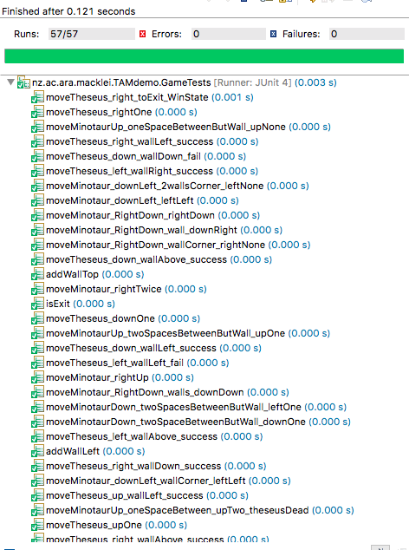
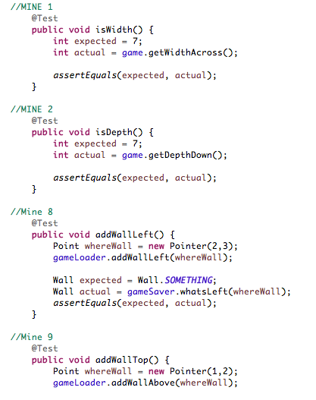
What I have done
Unit testing was the quickest way to test the model without creating the view.
I used unit tests to test things like player movement and level creation

Slide 94
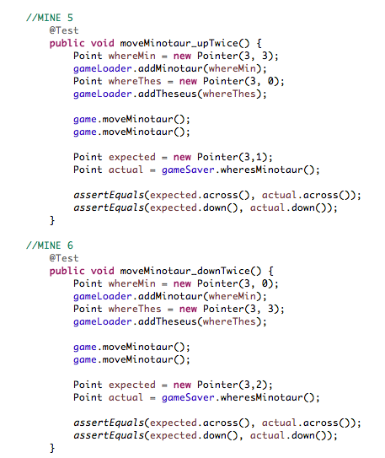
Comparison
COMPARISON
Another approach would be to create the view for the model and then use debugging and lots of different values until you got something to work. This is a slow approach and definitely not as good as unit testing.
VS

Slide 95
Evaluation, Statement
EVALUATION
Unit testing is a fast and efficient way to test sections of code to be sure that it does as intended. It is important to not be tempted to make one test method exercise more than one aspect of the unit's behavior. Doing so leads to tests that are difficult to read and update. It can also lead to confusion when you are interpreting a failure.
STATEMENT
It would have been good to test a more wide range of possibilities to get a more extensive idea on the possibilities of the model. It would also have benefited me if I had forethought the model before starting and then being unsure on what to unit test.

Slide 96
Theory #2
Code programs in the specified language using the prescribed standards.

Slide 97
State The Theory
Code conventions improve the readability of the software, allowing engineers to understand new code more quickly and thoroughly. Hardly any software is maintained for its whole life by the original author.

Slide 98
Credible Reference
http://www.oracle.com/technetwork/java/codeconventions-150003.pdf

Slide 99


What I Have Done
“Avoid lines longer than 80 characters, since they’re not handled well by many terminals and tools.”
Line Length – View Code
This line is the represents 80 characters
This also makes it a lot more easy to read as all the code can be seen without having to scroll right

Slide 100
Comparison
COMPARISON
Another approach would be to create not wrap text which would make really long lines which would make it a lot harder to read.
VS

Slide 101
Comparison, Evaluation, Statement
EVALUATION
Keeping the lines to less than 50 characters is the best approach as it improves readability
STATEMENT
I believe I mostly followed this convention which improved the readability of my code

Slide 102

What I have done
“Naming conventions make programs more understandable by making them easier to read.”
Naming Conventions– View Code
Classes
Class names should be nouns, in mixed case with the first letter of each internal word capitalized. Try to keep your class names simple and descriptive. Use whole words—avoid acronyms and abbreviations (unless the abbreviation is much more widely used than the long form, such as URL or HTML).
Examples
class Raster;
class ImageSprite;

Slide 103
What I have done
“Naming conventions make programs more understandable by making them easier to read.”
Naming Conventions– View Code
Methods
Methods should be verbs, in mixed case with the first letter lowercase, with the first letter of each internal word capitalized.
Examples
run();
runFast();
getBackground();

Slide 104
What I have done
“Naming conventions make programs more understandable by making them easier to read.”
Naming Conventions– View Code
Constants
The names of variables declared class constants and of ANSI constants should be all uppercase with words separated by underscores (“_”). (ANSI constants should be avoided, for ease of debugging.)
Examples
int MIN_WIDTH = 4;
int MAX_WIDTH = 999;
int GET_THE_CPU = 1;

Slide 105
Comparison, Evaluation, Statement
COMPARISON
Another approach would be to not follow the naming conventions but this would make it difficult for anyone else trying to read the code if they were use to Java coding conventions.
EVALUATION
Following the naming conventions improves readability for me and for anyone else needing to read the code
STATEMENT
I believe I mostly followed this convention which improved the readability of my code

Slide 106
Theory 3
Describe and use common Design Patterns, Algorithms and programming language Idioms.

Slide 107
Statement Of Theory
The Model-View-ViewModel (MVVM) pattern separates the modeling of the domain, the presentation, and the actions based on user input into three separate classes
Model: Data model representing the application business logic
View: The structure and appearance representation of the displayed content
ViewModel: Object linking the two together which deals with the view logic

Slide 108
Credible Reference
https://barta.me/android-mvvm-pattern/
https://blogs.msdn.microsoft.com/johngossman/2006/03/04/advantages-and-disadvantages-of-m-v-vm/

Slide 109



What I Have Done
<<MODEL>>
<<VIEW>>
<<VIEWMODEL>>
Has reference to model
and view
I have a model which managers the data, a view that displays the information and a controller that interprets the input. This helps with readability.

Slide 110
Comparison, Evaluation, Statement
COMPARISON
An alternative to MVVM is to not use separate files. This would mean having all the data, input interpretation and the display in one file. This would not make the code very reusable. Another way would for the view to talk directly to the model but this is bad practice as if you wanted to swap out the view or the model it would be a lot harder.
EVALUATION
MVVM is an effective way to bridge the View, and Model with a ViewModel. It makes the code a lot more reusable
STATEMENT
I believe I followed the MVVM layout effectively

Slide 111
Theory 4
Maintain existing programs and update documentation

Slide 112
State the theory
The fact is, most programming involves maintaining and modifying existing code.

Slide 113
Credible Reference
http://www.lcc.uma.es/~amg/ISE/OOP-Java-UML/Chapter8.html

Slide 114


What I Have Done
In my model, I originally had a cell could only contain Theseus or Minotaur, but this didn’t work when in the view for seeing if Theseus had been eaten by the Minotaur. So to fix this problem I had to change the cell to be able to have a Theseus and Minotaur.

Slide 115
Comparison, Evaluation, Statement
COMPARISON
There was no other way to do this that would suit my gameModel.
EVALUATION
This approach was very effective as I was able to display a lose state in the view
STATEMENT
This didn’t need any improvement as it worked as intented

